Slide 1
Google Dorks: Advanced Search Techniques
Unlocking Hidden Web Data Sagar Chhabriya
Apr 28, 2025

Slide 2
Introduction to Google Dorks
Google Dorks (or Google Hacking) are advanced search queries used to find specific information on the internet.
Purpose:
Discover hidden files, directories, or sensitive data.
Used by security researchers, hackers, and penetration testers.
Helps in cybersecurity assessments.

Slide 3
How Google Dorks Work
Google indexes billions of web pages.
Certain search operators ("dorks") refine searches to uncover vulnerable or exposed data.
Example:
site: example.com filetype:pdf → Finds pdfs on a specific website.

Slide 4
Common Google Dork Operators
Operator | Function | Example
site: | Searches only a specific website | site:example.com
filetype: | Finds specific file types | filetype:pdf
intitle: | Searches for text in page titles | intitle:"login"
inurl: | Searches for text in URLs | inurl:admin
cache: | Shows cached version of a page | cache:example.com
ext: | Alternative to filetype: | ext:sql
intext: | Searches for text within a page | intext:"password"
allintext: | Searches for all words in the page's text | allintext:username password

Slide 5
Practical Examples of Google Dorks
Finding Login Pages:
Intitle: “login” site:example.com
Exposed Documents:
filetype:pdf “confidential”
Vulnerable Webcams:
inurl: /view.shtml
Database Files:
filetype:sql “password”

Slide 6
Ethical Use of Google Dorks
Legal vs. Illegal Use:
Ethical hacking (bug bounty, security audits).
Unauthorized access (hacking, data theft).
Penalties: Unauthorized access can lead to legal consequences.

Slide 7
Protecting Against Google Dorks
For website owners:
Use robots.txt to block sensitive directories
Restrict access to admin panels.
Avoid exposing confidential files in public directories.

Slide 8
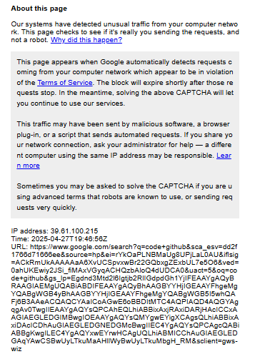
Sending Fishy queries lead to blocking ip add by goggle

Slide 9
Conclusion
Google Dorks are powerful search techniques.
Useful for cybersecurity professionals.
Must be used responsibly and ethically.

Slide 10
References
https://ahrefs.com/blog/google-advanced-search-operators/
https://github.com/PwnAwan/Google-Dorks/blob/main/files_containing_passwords.dorks
https://github.com/SagarChhabriya/Sem-6/tree/main/04-info-security

